Slide 1
Cross-cultural Differences in Parental Reactions to Temperament Displays and Relations to Child Temperament
The Joint Effort Toddler Temperament Consortium
I. Acar, A. Prokasky, S-Y. Han, B. Huitron, C. Gonzales-Salinas, S. P. Putnam, B. Linhares, M. Majdandzic, R. Montirosso, K. Heinonen, E. Kozlova, Z. Wang, S. Casalin, E. Ahmetoglu, O. Benga, C. de Weerth, & M. Gartstein
Occasional Temperament Conference
Seattle, WA
October 21-22, 2016

Slide 2
Background
Parents responses to children's temperament may play an important role in children’s development (Roberts, 1999).
Supportive responses (e.g., affirming of emotional expressions) are associated with positive social functioning (Eisenberg et al., 1996; McElwain, Halberstadt, & Volling, 2007)
Unsupportive responses (e.g., minimizing children’s emotional expression) are associated with lower levels of social competence and higher levels of problem behaviors (Fabes et al., 2001; Eisenberg et al., 1996).

Slide 3
…Cont’d
Indeed, parental responses to child negativity appear to be relevant to children’s social competence, emotional knowledge, emotional displays, friendship quality, and other social behaviors (Denham & Kochanoff, 2002; Eisenberg & Fabes, 1994; Eisenberg, Fabes, & Murphy, 1996; McElwain et al., 2007; Spinrad et al., 2007).
Socialization of emotions (e.g., parental support for emotions) occurs in a cultural context (Bornstein et al., 1992); therefore, expressions of children’s emotions and parents’ reaction to emotional displays are influenced by sociocultural context (Chen et al.,1998; Mesquita, 2007; Mesquita & Fridja, 1992).
Some cultures may emphasize expression of negative emotions (e.g., anger, fear) whereas some other cultures encourage suppression of negative emotions.
Wang (2001) found that Chinese mothers use “emotion-criticizing style” (installing proper behavior) while American mothers use “emotion-explaining style” (causal explanation for antecedents of emotions)

Slide 4
…Cont’d
Chen et al. (1998) reported that more punishment oriented child-rearing attitudes were expressed by Chinese-Canadian mothers (relative to their Canadian counterparts of European descent), and that this orientation was linked with higher toddler behavioral inhibition
Keller and Otto (2009) found differences between German and Cameroonian Nso mothers reactions to children’s emotions
Nso mothers were more likely to use directives and prompts to inhibit children’s negative emotionality as compared to German mothers
Cultural similarities of parental responses among American, French and Japanese mothers to child’s positive emotionality have been found too (e.g. Bornstein et al., 1992).

Slide 5
The Current Study
It has been shown that there are cultural differences in parental responses to emotions, however, very little is known about the ways that parental responses to children’s temperament may differ across cultures.
Understanding cultural differences in parental responses to temperament and their relations to child temperamental characteristics may create a common ground for researchers to interpret their findings from similar studies within cultural context.
We examined cultural differences in parental responses to temperament displays and their relations to child’s temperament across 13 cultures (N=704).

Slide 6
Methods
Participants were 704 children (311 female) from 13 countries (US, Brazil, Spain, Mexico, Italy, Russia, Finland, Romania, Belgium, the Netherlands, China, South Korea and Turkey).
Parents reported on their children’s temperament using the Early Childhood Behavior Questionnaire (Putnam, Gartstein, & Rothbart, 2006)
Parental responses to temperament displays were measured using the Very Brief Parental Responses to Temperament Displays Questionnaire (Putnam, 2002).
Notes:
Refer to introduction talk

Slide 7
PRTD- Parental Responses to Temperament Displays
Promoting surgency: Encouraging a child to engage active play such as running around, climb higher, and taking risk in the play
Promoting negative affectivity : Encouraging a child to express their feelings such as anxiety, fear, and anger
Praising effortful control : Rewarding or praising a child when they practice effortful control such as attention shifting, playing quietly by themselves for a long time, or inhibiting themselves from touching an unwanted item.
Punishing low effortful control: Punishing a child when he/she does not switch an activity when requested or do not stay on an activity for a while (e.g., > 5 minutes).

Slide 8
Results
Results from one-way Analysis of variance (ANOVA) suggested that there are significant differences between cultures on promoting surgency, promoting negative affectivity, praising effortful control, and punishing low effortful control.

Slide 9
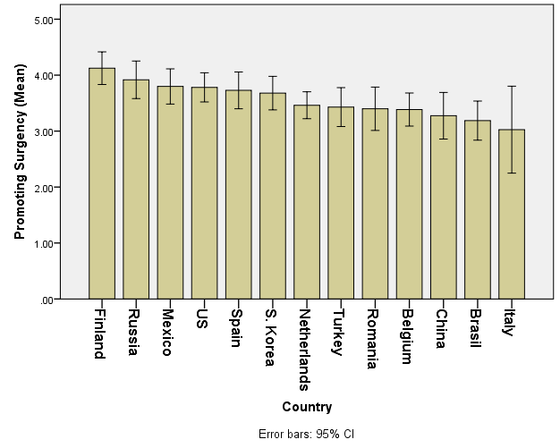
Promoting Surgency Across Cultures
Brazilian and Chinese parents scored lower than did Finnish parents

Slide 10
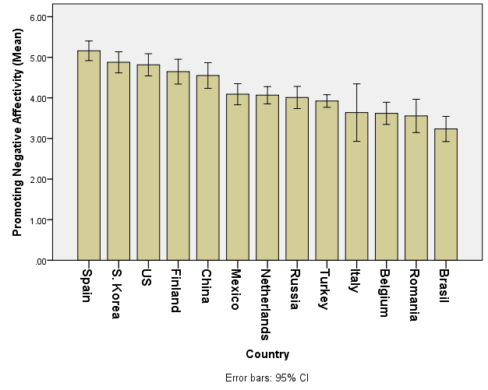
Promoting Negative Affectivity Across Cultures
Parents from Spain scored higher than parents from Mexico, Russia, Italy, Belgium, Netherlands, Romania, and Turkey did.
Brazilian parents scored lower than parents from S. Korea, Spain, Mexico, Russia, Finland, Netherlands, China, Turkey, and the U.S did.

Slide 11
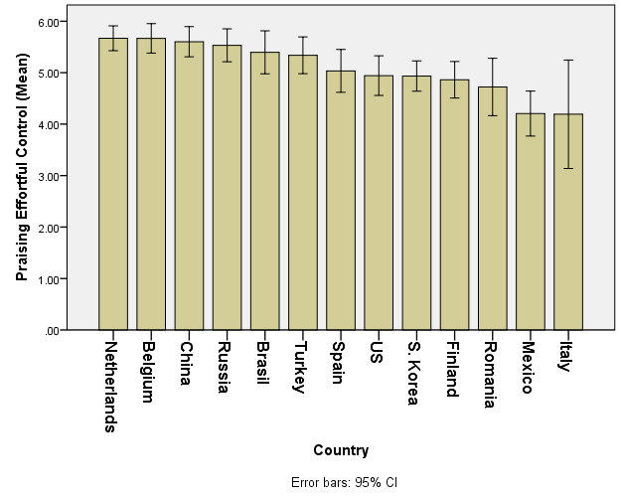
Praising Effortful Control Across Cultures
Parents from Mexico scored lower than parents from Russia, Belgium, Netherlands, China, and Turkey did.
Parents from Italy scored lower than parents from Belgium, Netherlands, and China did.

Slide 12
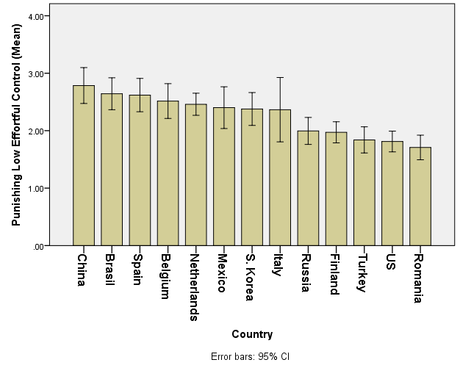
Punishing Low Effortful Control Across Cultures
Parents from Brazil scored higher than parents from Russia, Finland, Romania, Turkey, and the U.S. did.
Parents from Netherlands scored higher than parents from Romania, Turkey, and the U.S. did.

Slide 13
Associations between PRTD and Temperament Across Cultures
Cultures differed on associations between PRTD and temperament; For the full sample;
promoting negative affectivity was associated with effortful control (r = .11)
praising effortful control was associated with surgency (r = .08) and effortful control (r = .11)
punishing low effortful control was associated with negative affectivity (r = .20) and effortful control (r = -.09).

Slide 14
…Cont’d
For culture level;
Parent’s promotion of surgency was related to:
effortful control in Russia (r = .31)
surgency in Romania (r = -.30).
Parent’s promotion of negative affectivity was related to:
effortful control in South Korea (r=.29), Mexico (r = .28), Finland (r = .37), and the United States (r= -.29)
surgency in Spain (r = .26).

Slide 15
…Cont’d
Parents praise of effortful control was related to:
children’s effortful control in: Spain (r = .32), Mexico (r= .28), and the Netherlands (r = .32)
surgency in: South Korea (r = .27), Russia (r = .31), Belgium (r = .35), and Finland (r = -.31).
Parent’s punishment of low effortful control was related to:
surgency in South Korea (r = -.28), Russia (r = .29) and the United States (r = .26)
negative affectivity in China (r = .34) and Turkey (r = .42)
effortful control in Brazil (r = -.28).

Slide 16
Discussion and Future Directions
These results suggest there are cultural differences in parents’ responses to their children’s temperament displays
in turn, these responses may have different influences on children’s behaviors depending on cultural context (Chen, Yang, & Fu, 2012; Wang, 2001)
Results from the current study contribute to the understanding of within and between cultural effects of parents’ response to child temperament.
Investigate potential mediators between parental responses and children’s temperamental display (e.g., parental socialization or ethno theories within a culture).

Slide 17
Questions??
Thank you!
Ibrahim Acar: iacar2@unl.edu
Amanda Prokasky: aprokasky@unl.edu

