Slide 1
Cross-cultural differences in Temperament and Behavior Problems
Gonzalez-Salinas, C., Putnam, S. P., Linhares, B., Majdandzic, M., Lecannelier, F., Allabdullatef, N., Montirosso, R., Heinonen, K., Putnam, S. P., Kozlova, E., Wang, Z., Casalin, S., Ahmetoglu, E., Benga, O., Beijers, R., Gartstein, M. A., , Han, S-Y., & Garcia, V.

Slide 2
Research Questions
How does temperament differ cross-culturally?
How does behavior problem symptomology differ cross-culturally?
In general, how do temperament and symptomology relate?
Does culture moderate the relations between temperament and symptomology?

Slide 3
How does temperament differ cross-culturally?
Gaps in literature:
Several studies indicating cross-cultural differences, but most include only a few countries (c.f., Super et al., 2008), and several cultures have yet to be studied (e.g., Brazil, Mexico, Romania, Turkey, Saudi Arabia)
Relatively few studies of cross-cultural differences in toddlers (c.f., Cozzi et al., 2013; Slobodskaya et al., 2013)

Slide 4
How does temperament differ cross-culturally?
Previous research and associated expectations:
Putnam & Gartstein (2016), consolidating across multiple studies/ages, suggested the following:
Surgency:
High in Finland, Chile, Spain, U.S.
Moderate in Italy, S. Korea, Russia, Netherlands, Belgium
Low in China
Negative Affectivity:
High in Chile, S. Korea
Moderate in Russia, Spain, Italy, China, U.S.
Low in Netherlands, Finland, Belgium
Regulatory Capacity:
High in Netherlands, Finland, S. Korea
Moderate in Spain, Belgium, Chile, Russia, U.S., Italy
Low in China
Notes:
Skip over this, because it is repeated in upcoming slides

Slide 5
How does temperament differ cross-culturally?
Analyses/Results:
15 (country) X 2 (gender) ANOVAs, with age as covariate
Surgency
Country: F (14, 879) = 5.31, p < .001
Gender: F (1, 879) = 6.67, p < .01
Negative Affectivity
Country: F (14, 879) = 23.15, p < .001
Gender: F (1, 879) = 1.08, n.s.
Regulatory Capacity
Country: F (14, 879) = 3.87, p < .001
Gender: F (1, 879) = 5.90, p < .05
Notes:
Cover very quickly, just showing that Country was significant for all three

Slide 6
How does temperament differ cross-culturally? SURGENCY
Predicted:
High in Finland, Chile, Spain, U.S.
Moderate in Italy, Korea, Russia, Netherlands, Belgium
Low in China
Obtained:
High in Finland, Chile, Belgium
Moderate in Spain, Brazil, Saudi Arabia, Netherlands, Italy, Romania, Russia
Low in S. Korea, Turkey, Mexico, China, U.S.
Notes:
Go over this one somewhat slowly, to help audience get the idea. Later ones can go faster.

Slide 7
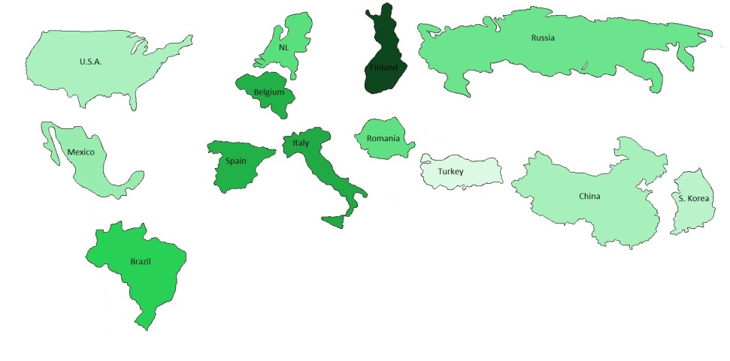
How does temperament differ cross-culturally? SURGENCY
Predicted:
High in Finland, Chile, Spain, U.S.
Moderate in Italy, S. Korea, Russia, Netherlands, Belgium
Low in China
Consistent or Inconsistent with Previous Research?
High in Finland, Chile, Belgium
Moderate in Spain, Brazil, Saudi Arabia, Netherlands, Italy, Romania, Russia
Low in S. Korea, Turkey, Mexico, China, U.S.
Notes:
Still go slowly. Point out the green indicating consistency, and that we see it in multiple countries and at different levels. The one discrepancy is the US sample

Slide 8
How does temperament differ cross-culturally? NEGATIVE AFFECTIVITY
Predicted:
High in Chile, S. Korea
Moderate in Russia, Spain, Italy, China, U.S.
Low in Netherlands, Finland, Belgium
Obtained:
High in China, Saudi Arabia
Moderate in S. Korea, Chile, Turkey, Brazil, S. Korea
Low in Romania, Russia, Belgium, Mexico, Italy, Netherlands, Finland, U.S.
Notes:
Can jump through this one quickly to get to next

Slide 9
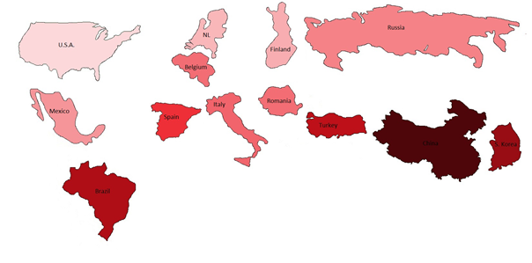
How does temperament differ cross-culturally? NEGATIVE AFFECTIVITY
Predicted:
High in Chile, S. Korea
Moderate in Russia, Spain, Italy, China, U.S.
Low in Netherlands, Finland, Belgium
Consistent or Inconsistent with Previous Research?
High in China, Saudi Arabia
Moderate in S. Korea, Chile, Turkey, Brazil, S. Korea
Low in Romania, Russia, Belgium, Mexico, Italy, Netherlands, Finland, U.S.
Notes:
Moderate consistency overall, but notable consistency in finding low negative affect in Northern Europe.

Slide 10
How does temperament differ cross-culturally? REGULATORY CAPACITY
Predicted:
High in Netherlands, Finland, S. Korea
Moderate in Spain, Belgium, Chile, Russia, U.S., Italy
Low in China
Obtained:
High in S. Korea, Spain, Romania, Mexico
Moderate in U.S., Brazil, Netherlands, Finland, Italy, Chile, Belgium, Russia
Low in Saudi Arabia, China, Turkey.
Notes:
Skip quick

Slide 11
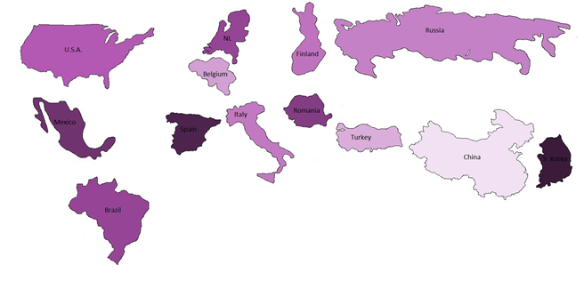
How does temperament differ cross-culturally? REGULATORY CAPACITY
Predicted:
High in Netherlands, Finland, S. Korea
Moderate in Spain, Belgium, Chile, Russia, U.S., Italy
Low in China
Consistent or Inconsistent with Previous Research?
High in S. Korea, Spain, Romania, Mexico
Moderate in U.S., Brazil, Netherlands, Finland, Italy, Chile, Belgium, Russia
Low in Saudi Arabia, China, Turkey
Notes:
Considerable consistency! Didn’t find super-high reg capacity in NL and Finland, but otherwise quite consistent.

Slide 12
Research Questions
How does temperament differ cross-culturally?
How does behavior problem symptomology differ cross-culturally?
In general, how do temperament and symptomology relate?
Does culture moderate the relations between temperament and symptomology?

Slide 13
How does behavior problem symptomology differ cross-culturally?
Background:
Prevalence and onset ages of disorders vary widely across cultures (Kessler et al., 2009)
Rescorla et al. (2011) compared behavior problems in preschool children across 24 countries (including 12 JETTC cultures), finding…
Low scores in Spain and S. Korea
High scores in Romania, Turkey and Chile

Slide 14
How does behavior problem symptomology differ cross-culturally?
Results:
15 (country) X 2 (gender) ANOVAs, with age as covariate
Internalizing
Country: F (14, 853) = 9.25, p < .001
Gender: F (1, 853) = .15, n.s.
Externalizing
Country: F (14, 853) = 5.78, p < .001
Gender: F (1, 853) = 1.60, n.s.
Total
Country: F (14, 853) = 7.21, p < .001
Gender: F (1, 853) = .59, n.s.
Notes:
Go through quick. Country always significant, gender is not!

Slide 15
How does symptomology differ cross-culturally? INTERNALIZING
Obtained:
High in Saudi Arabia, China, Turkey, Brazil
Moderate in Chile, Mexico, Romania, Russia
Low in U.S., Netherlands, S. Korea, Finland, Belgium, Italy, Spain.
Notes:
Italics indicate consistent with Rescorla. Underline is not inconsistent (so Turkey, S.K and Spain are, Chile expected to be high but not).
Give hint toward later correlations by pointing out that S.A., China, had been high on Neg Aff, and NL, Finland, Belgium were low

Slide 16
How does symptomology differ cross-culturally? EXTERNALIZING
Obtained:
High in Chile, Brazil
Moderate in Italy, NL, Turkey, Romania, Spain, China, Saudi Arabia, Belgium, Mexico, Russia, Finland
Low in U.S., S. Korea
Notes:
Nothing much to say here, don’t go through list of moderates, just the highs and lows

Slide 17
Research Questions
How does temperament differ cross-culturally?
How does behavior problem symptomology differ cross-culturally?
In general, how do temperament and symptomology relate?
Does culture moderate the relations between temperament and symptomology?

Slide 18
How do temperament and behavior problems relate?
Background:
Previous research (e.g, Gartstein, Putnam & Rothbart, 2012) finds…
Both Internalizing and Externalizing predicted by high Negative Affectivity and low Regulatory Capacity
Surgency is associated with low Internalizing, but high Externalizing

Slide 19
How do temperament and behavior problems relate?
Two different levels:
- Between cultures (i.e., is country-level temperament predictive of country-level symptoms?)
- correlations (n = 15) between marginal means
- Within cultures (i.e., are individual temperament profiles predictive of symptoms?)
- correlations (ns from 48 to 98) between individuals’ scores

Slide 20
How do temperament and behavior problems relate?
Between cultures (N = 15)
Average within-culture correlations
 | INT | EXT
SUR | -.20 | .60*
NEG | .76** | .08
REG | -.60* | -.33
 | INT | EXT
SUR |  | .60*
NEG | .76**
REG | -.60*
 | INT | EXT
SUR | .00 | .20^{*5}
NEG | .47^{*14} | .36^{*13}
REG | -.21^{*4} | -.45^{*15}
 | INT | EXT
SUR
NEG | .47^{*14} | .36^{*13}
REG |  | -.45^{*15}
 | INT | EXT
SUR |  | .20^{*5}
NEG
REG | -.21^{*4}

Slide 21
Research Questions
How does temperament differ cross-culturally?
How does behavior problem symptomology differ cross-culturally?
In general, how do temperament and symptomology relate?
Does culture moderate the relations between temperament and symptomology?

Slide 22
Does culture moderate the relations between temperament and symptomology?
Background:
Cross-cultural differences have been demonstrated in what parents find “difficult” (Super et al., 2008)
High Negative Affectivity and Low Soothability more strongly related to behavior problems in US than Russian children (Gartstein et al., 2013)

Slide 23
Does culture moderate the relations between temperament and symptomology?
Range of correlations within cultures
 | INT | EXT
SUR | -.23/.27 | -.00/.46
NEG | .33/.72 | .20/.56
REG | -.42/-.12 | -.60/-.35
Notes:
Huge variability. Range of at least .25 between lowest and highest, some up to .70!

Slide 24
Does culture moderate the relations between temperament and symptomology?
Countries with very high or low correlations between temperament and problems
Surgency:
With externalizing:
Brazil (.38), Chile (.45), Russia (.46), Mexico (-.00), Belgium (.06), S.A. (.05)
Negative Affectivity
With internalizing:
Brazil (.72), Chile (.61), S. Korea (.60), Finland (.33), NL (.35), S.A. (.38)
With externalizing
Brazil (.56), Chile (.48), S. Korea (.50), Belgium (.20), Italy (.20), Turkey (.28)
Regulatory Capacity
With internalizing:
Brazil (-.42), Chile (-.31), Belgium (-.27), NL (-.27), Romania (-.12), S. Korea (-.13)
With externalizing:
Brazil (-.60), Chile (-.56), Belgium (-.53), Turkey (-.35), Romania (-.36), Italy (-.37)
Notes:
Brazil and Chile almost always the highest. For Belgium, reactive traits are barely related to behavior problems, but regulatory are strongly related, opposite for S. Korea.

Slide 25
Conclusions
Substantial cross-cultural effects are apparent in toddler temperament and behavior problems
Largely consistent with previous studies
SUR: high in Finland, Chile; low in China
NEG: low in N. Europe
EFF: high in S. Korea; low in China
Behavior Probs: high in Turkey, Chile; low in S. Korea, Spain
Connections between behavior problems are apparent at both between- and within-country levels
more tightly related in S. American samples than in other locations

Slide 26
Future Directions
Closer examination of differences and connections at the scale level
Examination of biological factors associated with these differences
Connecting these differences to broad, societal differences, as well as discrete environmental processes
…including Daily Activities and Parental Reactions to Temperament

