Slide 1
Temperament and Teacher-Child Conflict in Preschool: Buffering Effects of Classroom Quality
Kathleen Moritz Rudasill
Leslie Hawley
Victoria J. Molfese
Xiaoqing Tu
Amanda Prokasky
Kate Sirota
University of Nebraska-Lincoln
Article in press in Early Education and Development

Slide 2
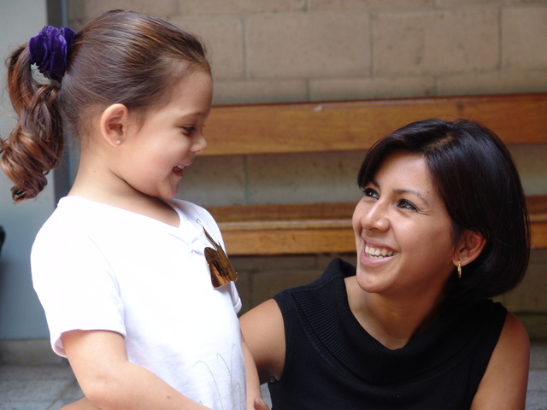
Early teacher-child relationships are critical for long-term outcomes (e.g., Hamre & Pianta, 2001)

Slide 3
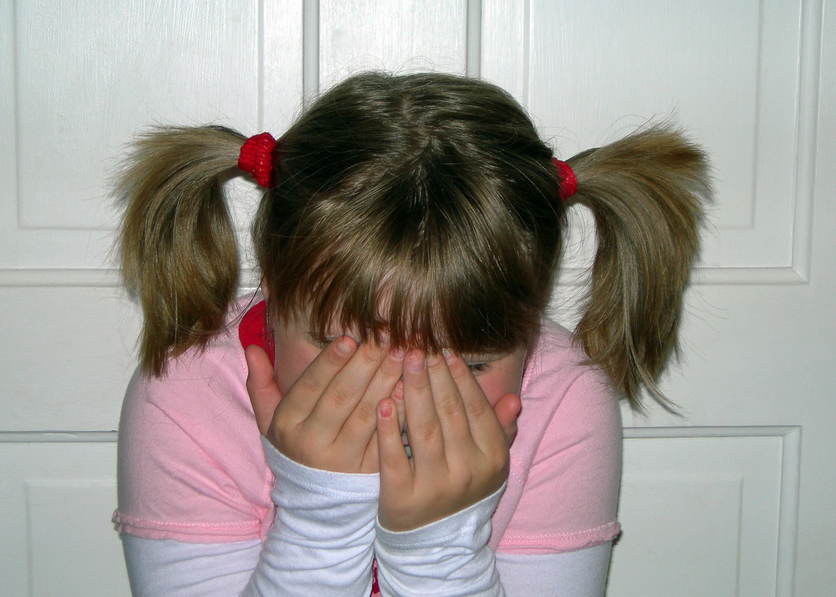
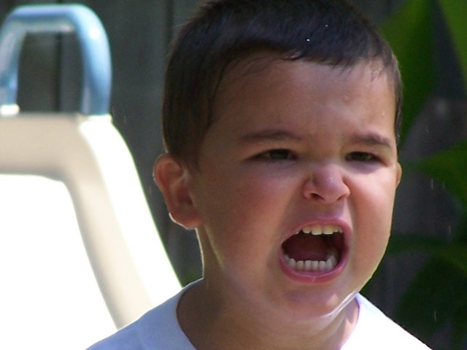
Effortful Control
Shyness
Less
TEACHER-CHILD CONFLICT
Anger
More
Justice et al., 2008; Rudasill & Rimm-Kaufman, 2009; Rydell et al., 2005

Slide 4
Classroom Quality and Teacher-Child Conflict
Instructional support
(concept development, quality of feedback, language modeling)
Emotional support
(positive & negative climate, regard for student perspectives, sensitivity)
⬇
Buffering
for children at risk
(Functional risk: Hamre & Pianta, 2005; Internalizing & externalizing: Buyse et al., 2008)

Slide 5
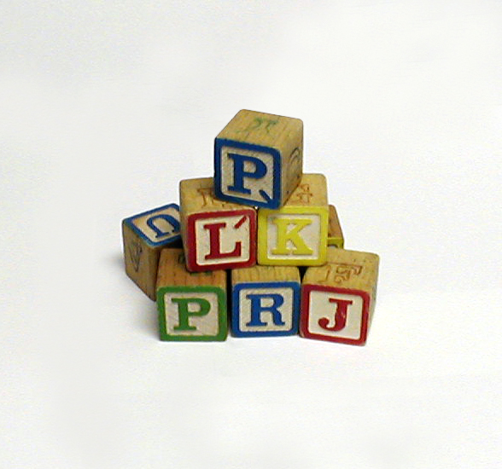
Present Study
Temperament
Classroom quality
Teacher-child conflict
Preschool sets the stage for children’s initial impressions of teachers and school and is a period of major growth in self-regulatory skills

Slide 6
Method
Participants – 104 children (56 female), 23 classrooms, 9 programs, ~ 4.5 children per classroom, M age = 50 months
Measures
Demographics – parent questionnaire
Teacher-child relationship quality – STRS (Pianta, 2001) (e.g., “Dealing with this child drains my energy”)
Classroom quality – CLASS (Pianta et al., 2008)
Child temperament – CBQ (Rothbart et al., 2001) anger, shyness, effortful control

Slide 7
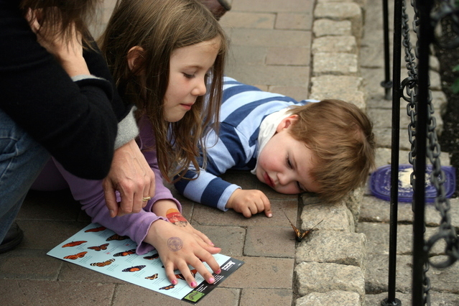
Method
Procedure
Fall: parents completed demographic questionnaire, teachers completed CBQ
Winter: researchers observed with CLASS
Spring: teachers completed STRS

Slide 8
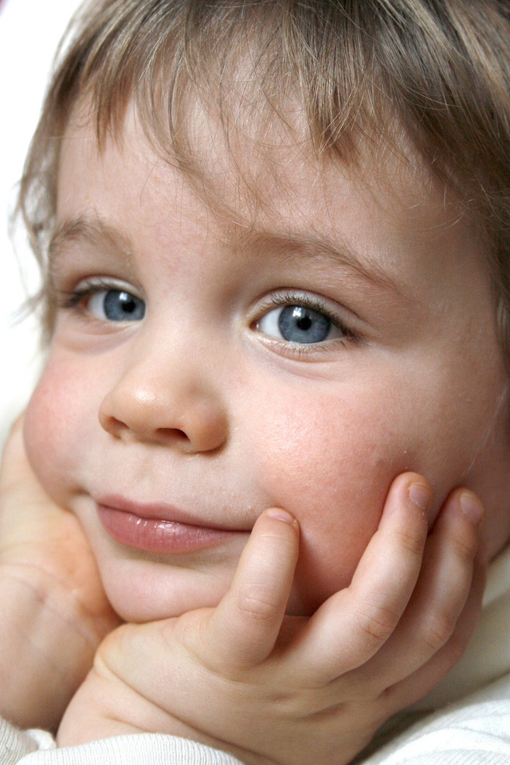
Method
Data analysis
two-level models
DV: Conflict
IVs:
covariates
temperament
classroom quality
all two way interactions (temperament x classroom quality)

Slide 9
Results

Slide 10
Effortful Control x Emotional Support
In low ES classrooms, children have less conflict with teachers as effortful control increases. In high ES classrooms, all children have similar conflict.

Slide 11
Emotional support x effortful control
Congruent with work showing ES is protective for kids at risk
BUT high ES classroom teachers rated ALL kids higher in conflict → Maybe they’re noticing more, working harder?
ES varies more across the day in high ES classrooms which predicts more conflict (Brock & Curby, 2014) → so higher EC kids may find that frustrating

Slide 12
Effortful Control x Instructional Support
In high IS classrooms, children have less conflict with teachers as effortful control increases. In low IS classrooms, all children have similar conflict.

Slide 13
Instructional support x effortful control
IS scores in our sample:
M = 3.07, -1 SD = 1.95, +1 SD = 4.19
Contrast between below and above average IS classrooms: rote learning vs. questioning, scaffolding
higher IS = increased cognitive demand and potentially more frustration (e.g., Dominguez et al., 2011)
at-risk kids may need regulation skills before benefitting from demanding instruction (Rudasill et al., 2016; Vitiello et al., 2012)

Slide 14
Discussion
Correlations:
Temperament and Teacher-Child Conflict
Shyness and anger not correlated with conflict
Gender not correlated with conflict
Inconsistent with previous research – perhaps overshadowed by effects of effortful control
Age negatively correlated with conflict
Research is inconclusive

Slide 15
Implications for Research & Practice
Importance of teacher support/coaching (My Teaching Partner)
Value of eacher training on:
-temperament-based practices (INSIGHTS)
-relationship-building skills (Banking Time)

Slide 16
Limitations and Next steps:
Teachers rated BOTH children’s temperament and teacher-child relationship quality
Small sample
Short timeframe
Current study following children from toddlerhood through pre-kindergarten
Combines temperament, sleep, parenting, and classroom processes

